Slide 1

Air Quality Forecasting(CO2 emissions)
Project P-143
Start Date: 15/08/2022
Mentor Name: Neha Gupta
Team Members
Alka Aswar
Ankita Phad
Priyanka Pagar
Rohit Banate
Mohit Shrimali
Tarang Deshbhratar

Slide 2
Agenda:
Objective
Data Understanding
EDA
Feature Transformation
Model Building
Results
Deployment

Slide 3
Business Problem:
Problem Statement
We have a dataset of previous 215 years from 2014, we need to analyze the dataset and considering various factors impacting the CO2 emissions.
Objective:
To forecast CO2 levels for an organization so that the organization can follow government norms with respect to CO2 emission levels.

Slide 4
PROJECT FLOW
Business Problem
Load Dataset & Observe it
EDA
Visualization
Model Building
Splitting the data into Train and Test set and Feature Scaling
Feature Selection
Model Deployment

Slide 5
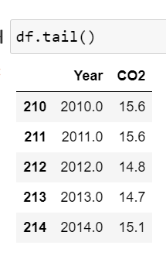
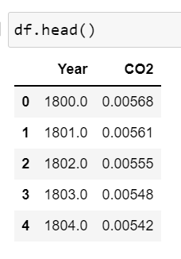
The Data

Slide 6
Exploratory Data Analysis (EDA) and
Feature Engineering

Slide 7
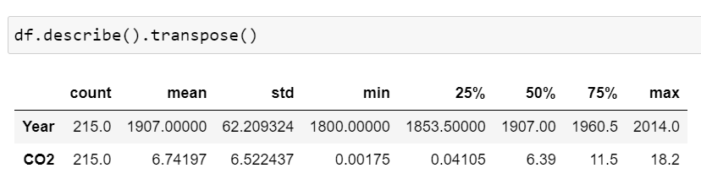
Data set details
Total Rows: 215
Total Columns: 2
Missing values: 0
Duplicate values: 0
Features Name: Year, CO2
Data Types:
Year – Datetime64
CO2 – Float
Data Description:

Slide 8
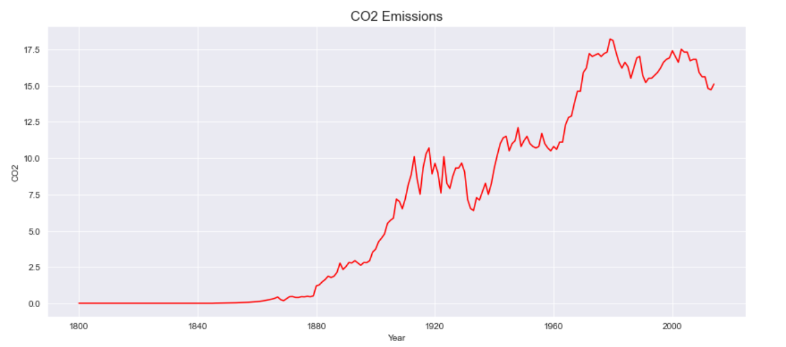
Exploratory Data Analysis (EDA)
The Line plot

Slide 9
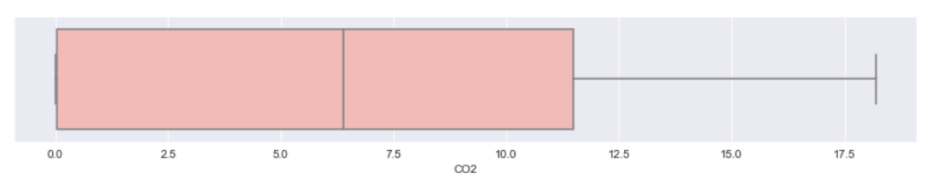
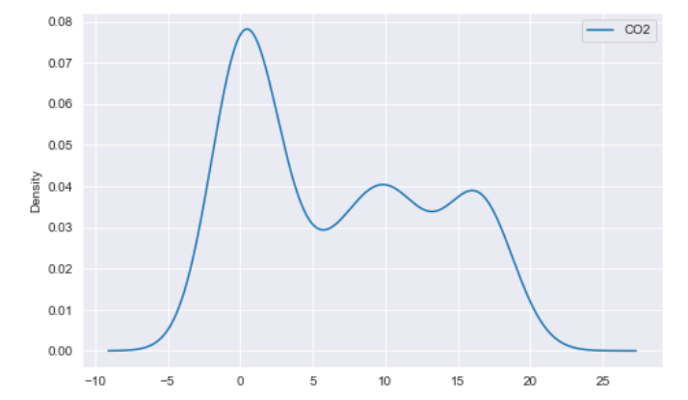
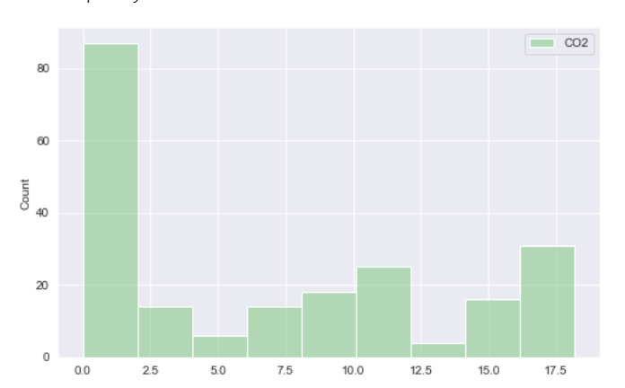
Exploratory Data Analysis (EDA)
Box plot
KDE
Histogram

Slide 10
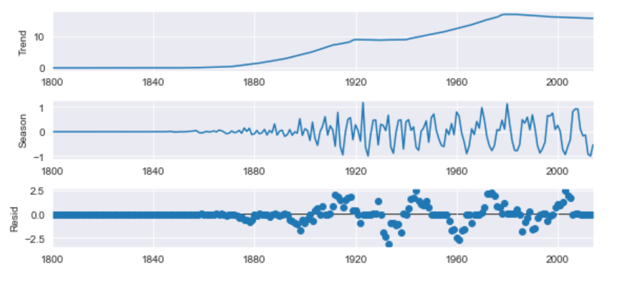
Exploratory Data Analysis (EDA)
Automatic Time series decomposition using STL
(Seasonal-Trend decomposition using LOESS)
STL uses LOESS (locally estimated scatterplot smoothing
Trend – upward trend
Seasonality – cyclic patterns
Noise – Random variation

Slide 11
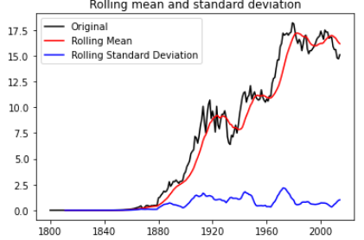
Exploratory Data Analysis (EDA)
Check for stationary

Slide 12
Exploratory Data Analysis (EDA)
37% CO2 values are less then 1.
The statistical properties(e.g., mean) of CO2 levels are changing over time means the time series is non-stationary.
The levels of CO2 increasing over time.
Highest CO2 level was in the year 1979.
Since 1970, CO2 levels have increased by about 90%
queries:
The dataset contains 215 entries out of 80 entries have CO2 levels < 1%
Can we consider them as outliers? Is it possible that the CO2 levels can be nearer to 0?

Slide 13
Exploratory Data Analysis (EDA)
Transform the non-stationary time series to stationary.
Apply First Differencing Technique
Differencing - a method of transforming a time series
Remove trend, seasonality, skewness.

Slide 14
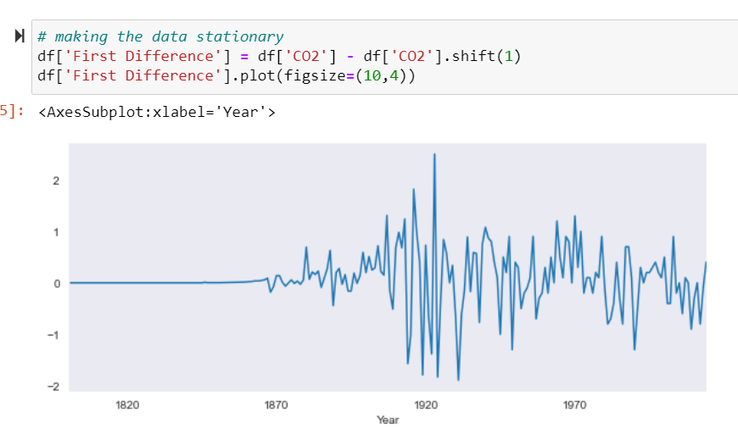
Feature Transformation
Differencing

Slide 15
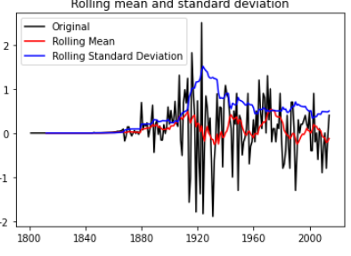
Feature Transformation
Before Applying First Differencing
After Applying First Differencing

Slide 16
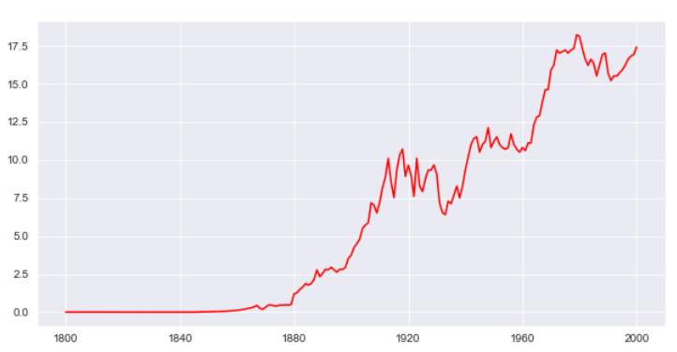
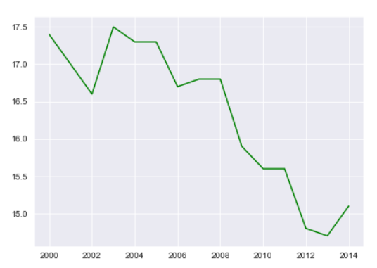
Trial Test Split
Train data
Test data

Slide 17
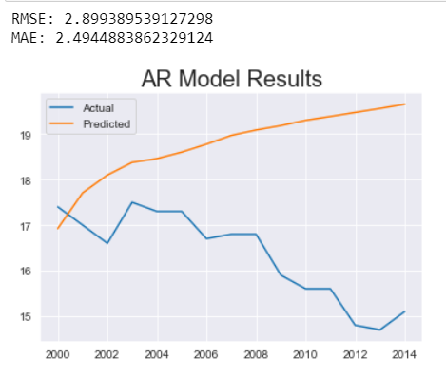
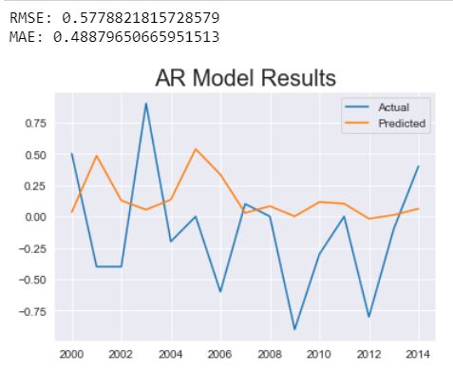
Models
AR Model
AR Model- First Difference

Slide 18
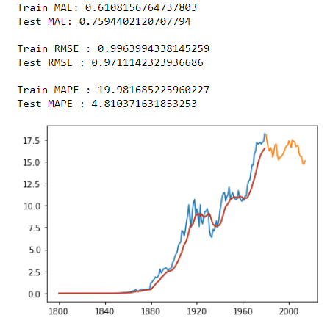
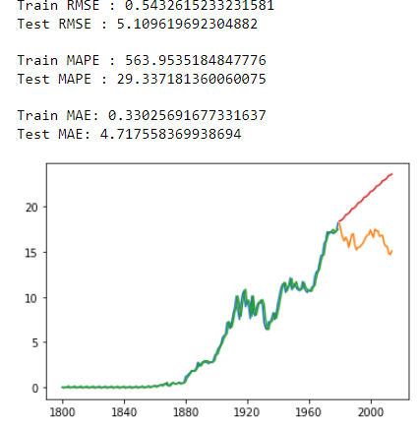
Models
Simple Exponential Method
Holt method(Additive trend & seasonality)

Slide 19
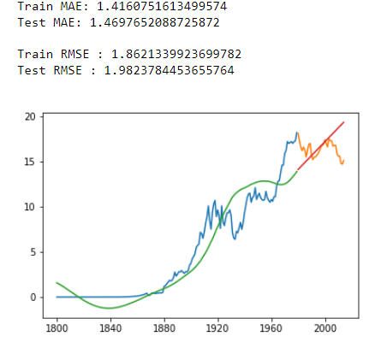
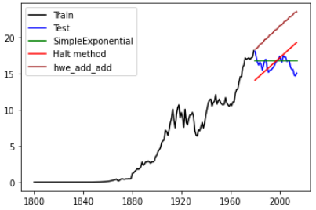
Models
Holt Method
Best fit model

Slide 20
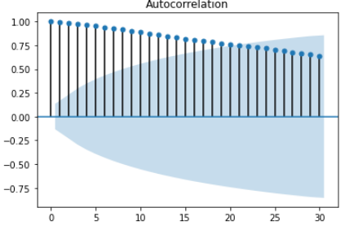
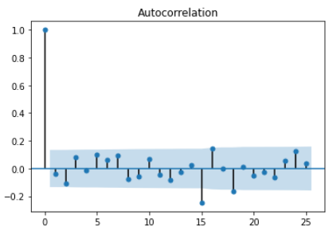
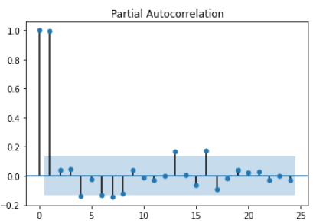
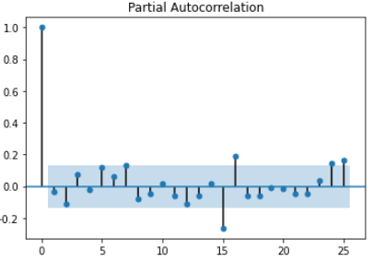
Models
First We will check p,d,q value for Arima Model . Using Ac and Pacf plot we can check for p,d,q and seasonality
Original Data
After First Differencing

Slide 21
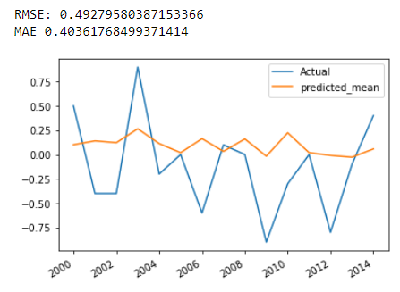
Models
Arima

Slide 22
Results
Sr No. | Model Name | RMSE Value | MAE Value
1 | AR | 0.5778 | 0.4887
2 | ARIMA | 0.4927 | 0.4036
5 | Simple Exponential | 0.9711 | 0.7594
6 | Holt Method | 1.4160 | 1.8621
7 | Holt Add Method | 5.1096 | 4.7175

Slide 23
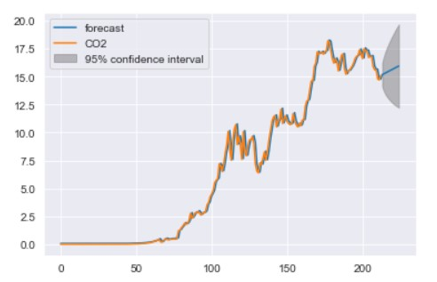
The final model-ARIMA
Forecast For Next 10 Years Using ARIMA with 95% confidence interval

Slide 24
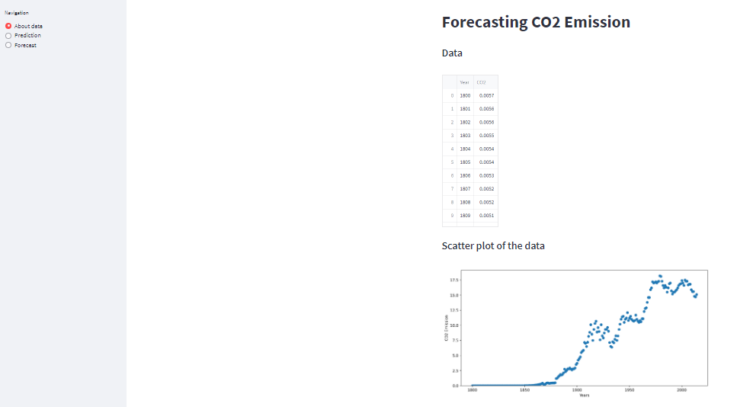
User Interface
This Interface is created using streamlit Python

Slide 25
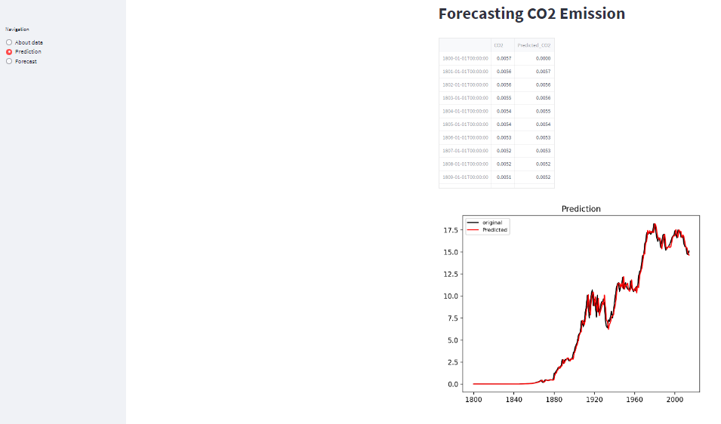
User Interface

Slide 26
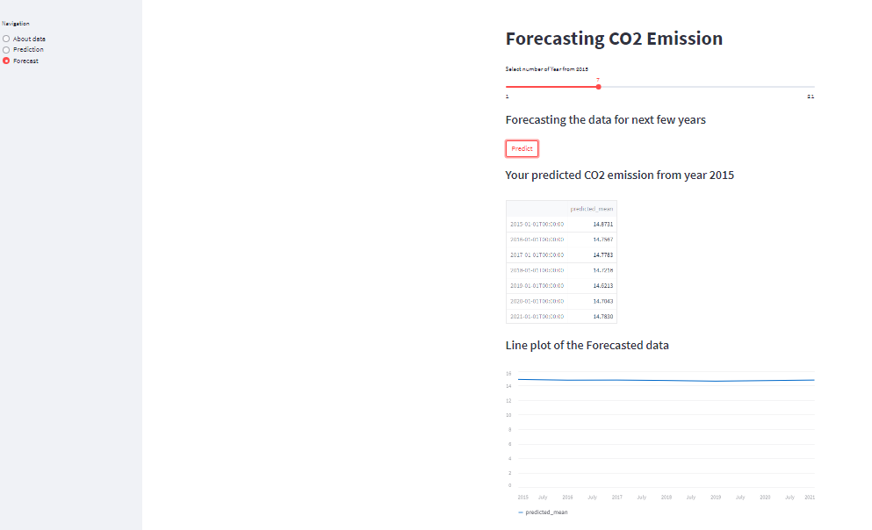
User Interface

Slide 27
Thank you !

